Slide 1
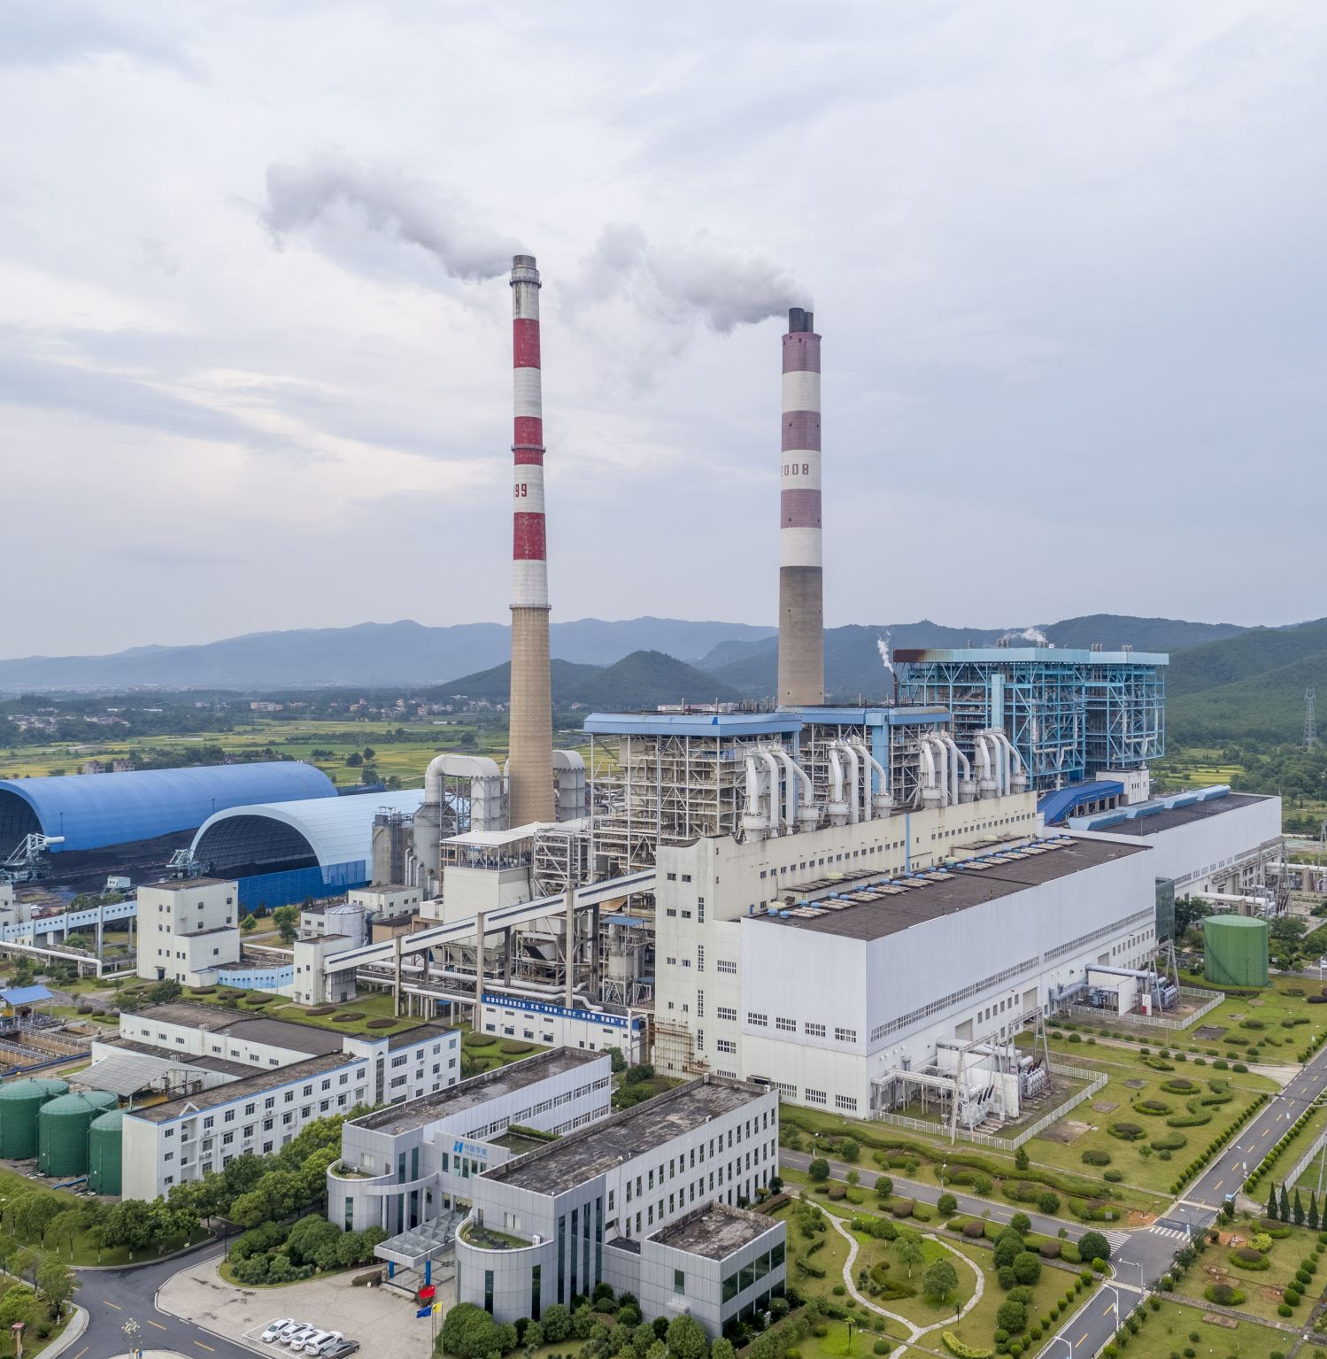
Predicting the Energy Output of a Combined Cycle Power Plant
By:
Jefferson Fernandez

Slide 2
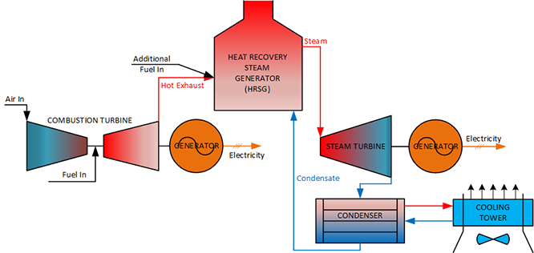
1. Introduction
A combined-cycle power plant uses both a gas and a steam turbine together to produce up to 50% more electricity from the same fuel than a traditional simple-cycle plant
Source: GE

Slide 3
2. Problem Definition
How do we predict the energy out of a combined cycle power plant at full power given for features, which are Ambient Temperature, Ambient Pressure, Relative Humidity, and Exhaust Vacuum?

Slide 4
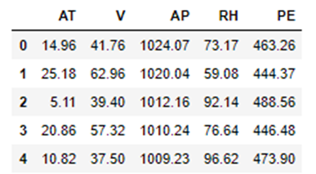
3. Data
CSV file from UCI Machine Learning Repository
9568 rows
Collected over a period of 6 years
Temperature (T) in the range 1.81 C and 37.11 C
Ambient Pressure (AP) in the range 992.89 1033.3 mmilibar,
Relative Humidity (RH) in the range 25.56% to 100.16%
Exhaust Vacuum (V) in the range 25.36-81.56 cm Hg
Net hourly electrical energy output (EP) 420.26-495.76 MW

Slide 5
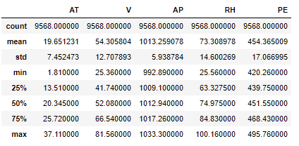
4. Data Wrangling and Exploratory Data Analysis
No missing value in the dataset
No negative value in the dataset
The mean output of the power plant at full load is at 454 MW
Data does not need to be prepared as it already comes at the right format

Slide 6
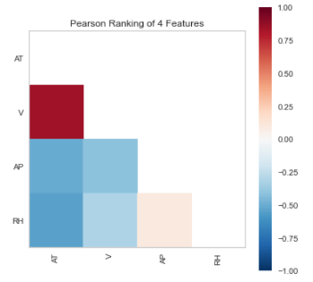
The Pearson Ranking shows the correlation between the different features and as can be inferred from the figure, the exhaust vacuum pressure and temperature are highly correlated.

Slide 7
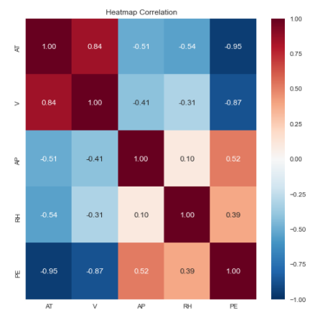
The heatmap correlation shows the relationship between the features and Energy Output which shows an inverse relationship between Atmospheric Temperature and Energy Output.

Slide 8
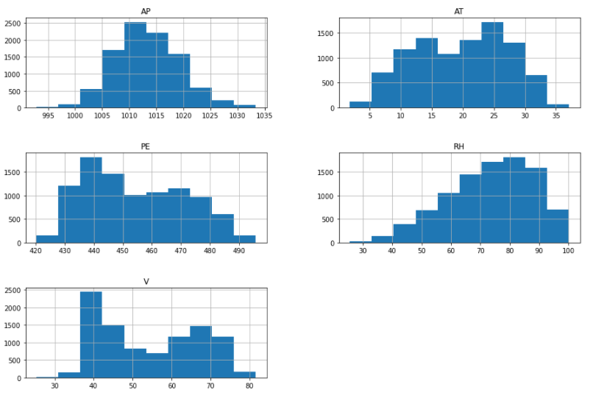
Histogram of each column of data that shows the distribution for each figure.

Slide 9
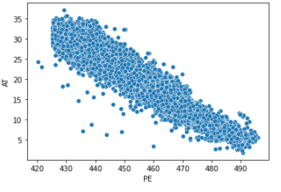
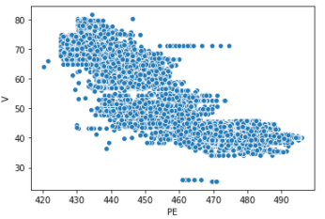
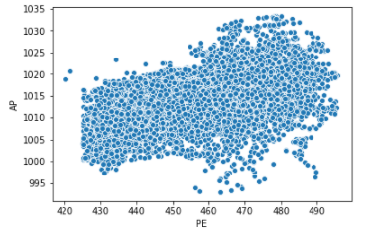
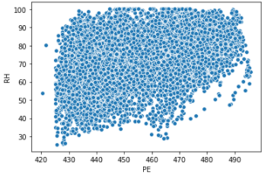
Plotting each variable against the Electric Energy Output (PE) we can see an inverse relationship between Atmospheric Temperature and PE.

Slide 10
5. Preprocessing and Training
6 different regression machine learning algorithms were chosen, and bench marked against our base model (mean output).
These models are linear regression, random forest, AdaBoost, GradientBoost, Multi-layer Perceptron, XGBoost.
70% of data set assigned as learning set and the remaining set assigned as test set.
The mean absolute error of the base model is 15 MW. This is significant error because a megawatt can typically power 800 households and in our case under predicting or over predicting power for 12,000 households.
Cross-Validation was used for each model to avoid overfitting.
Hyperparameter tuning was employed for each model in order to find the best case for each machine learning model.
Over 30+ models were examined and the best model for each algorithm was picked.

Slide 11
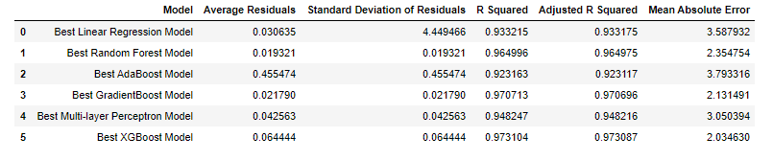
6. Modelling
XGBoost Model is the best performing model with the lowest Mean Absolute Error, and highest Adjusted R Squared value.

Slide 12
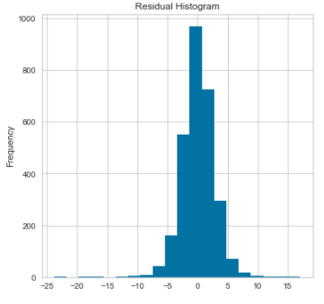
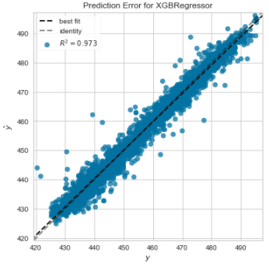
The histogram of the XGBoost Model residuals from the test set shows that it looks normal, with a prediction error value between -7 and 7.

Slide 13
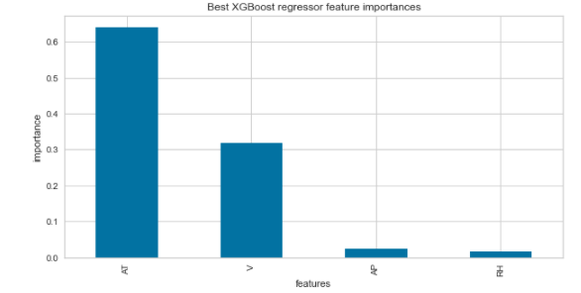
As expected, the most important feature is the atmospheric temperature is the most important feature as expected. Colder temperature is correlated with the performance of a turbine engine since colder air is denser thus leading to a higher air fuel ratio and increased turbine efficiency or power output.

Slide 14
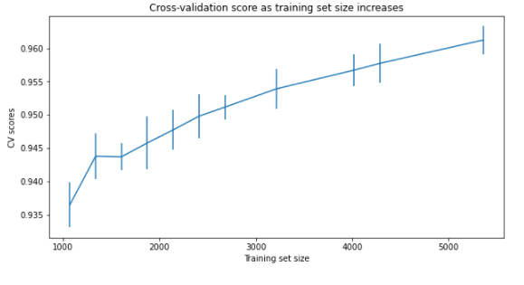
To check whether collecting more data will further improve the performance of our model a learning curve was built. The learning curve plots the training and cross-validation score as the model is created with more samples. As can be seen from the figure below collecting more data will not significantly increase the cross-validation score as it is already at 96%.

Slide 15
7. Conclusion and Recommendations
The XGBoost Machine Learning Model is significantly more accurate than simply using the average value of the electric energy output. The model is 85% more accurate compared to the baseline model. Below are our Recommendations.
Deploy the best XGboost Machine Learning that way the resource department could utilize it in predicting the electric output of the powerplant.
Start the conversation about building a similar model for every single power plant owned by the company.
Since the data collected comes from the combined cycle power plant at full load, the powerplant maintenance department could potentially use this model to figure out whether the plant is operating in an optimal and predict the need for maintenance (i.e., The model predicted an output of 500 MW but the actual output is only 300 MW.).

Slide 16
8. Consulted Resources
Springboard Materials
Machine Learning Pocket Reference by Matt Harrison
Hands-On Machine Leaning with Scikit-Learn Keras and TensorFlow by Geron
Practical Statistics for Data Scientist by Bruce and Bruce

